Slide 1
Respiratory Failure Section
Presented by: Nilüfer Öztürk and David Tingay
23 June 2023; Athens

Slide 2
Changes to the ARF Section
The Respiratory Section would like to thank Robert for his excellent Leadership
Robert Blokpoel (Chair) stepped out of role in 2022
Dept Chair: Nilüfer Öztürk (and interim Chair), David Tingay (interim)
2023 Chair: David Tingay
2023 Dept Chair: Nilüfer Öztürk
Notes:
Thanks to Robert

Slide 3
Educational Projects
Strong Educational Program:
Total 2479 Attendance for 2022/23
NIV Workshop ESPNIC
Online Courses:
Mechanical Ventilation (3 x 2022-23) and NIV (2021
Webinair:
PARDS, Neonatal Ventilation, MV in PICU, Bronchoscopy/videolaryngoscopy
Endorsed Courses
Sheffield, Turkey and Romania (2023)

Slide 4
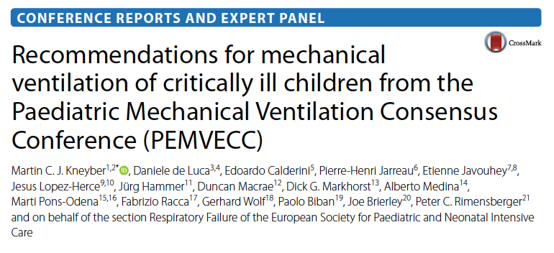
Current Research: PEMVECC 2.0
Timeline for completion Dec 2023
Notes:
Martin To discuss

