Slide 1
POKER
PICU Oncology Kids in Europe Research group
Our ultimate goal is to improve the care and health outcomes of critically ill pediatric cancer patients.

Slide 2
POKER consortium
24 PICUs from 11 European countries
Research priorities
Sepsis and Acute respiratory failure
Overview of Current Activities
Publications 2022
Role of extracorporeal membrane oxygenation in pediatric cancer patients: a systematic review and meta-analysis of observational studies. Ann Intensive Care 2022; 29: 8
Extracorporeal membrane oxygenation in children receiving haematopoietic cell transplantation and immune effector cell therapy: an international and multidisciplinary consensus statement. Lancet Child Adolesc Health 2022; 6: 116-128
Organizational characteristics of European pediatric onco-critical care: An international cross-sectional survey. Front Pediatr 2022; 10: 1024273
Current project: Clinical phenotypes in pediatric cancer patients with sepsis
Two cohorts (European and U.S. cohort)
~ 2300 patients
Preparation of European registry

Slide 3
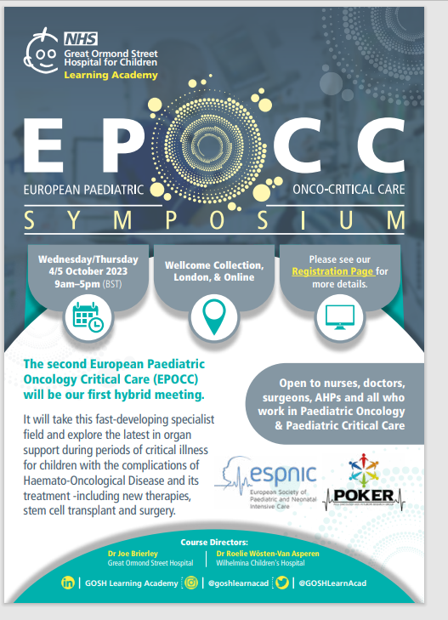
Events

