Slide 1
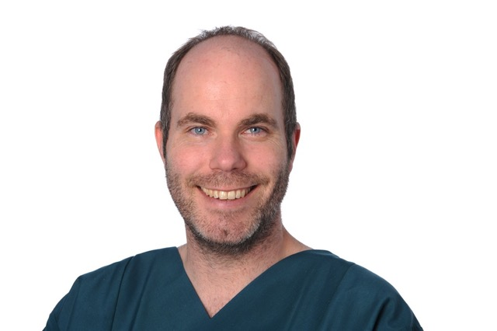
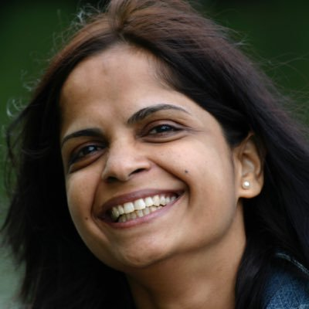
Neurocritical Care Section
Karl F. Schettler Shruti Agrawal
Chair Deputy Chair

Slide 2
Educational Activities of Neurocritical Care Section
Webinar Series
Neuromonitoring during cardiac surgery and cardiac intensive care in children (Ken Brady)
Mulit-modal Neurominitoring in Pediatric Critical Care (Brian Appavu)
TCD in Paediatric brain injury (Francisco Abecasis)
Amplitude-integrated EEG background in children – what´s normal (Nora Bruns)
Cerebral autoregulation in TBI (Shruti Agrawal)
aEEG in the cardiac/surgery patient (Karl F. Schettler)
Data collection and derivates in Neuro-ICU (Peter Smielewski)
Neurocritical Care Section

Slide 3
Educational Activities of Neurocritical Care Section
Webinar Series - Statistics
Average Rating 9.13 of 10
Up to 1017 registered for a webinar
Total number of different countries from which people have registered 127
Season 2 is coming soon !
Also: First Masterclass on aEEG neuromonitoring in NICU and PICU here in Athens
Neurocritical Care Section

Slide 4
Scientific Activities of Neurocritical Care Section
Contact with Pediatric Neurocritical Care Research Group (PNCRG)
Presenting work of the section and ESPNIC
Improve general networking of our section and PNCRG
Connecting and presenting members of our section looking for research opportunities
Projects of working group on neuromonitoring
Developing database framework for neuromonitoring registries
Developing future guidelines on neuromonitoring
Neurocritical Care Section

