Slide 1
Neonatal Critical Care Section
June 2023

Slide 2
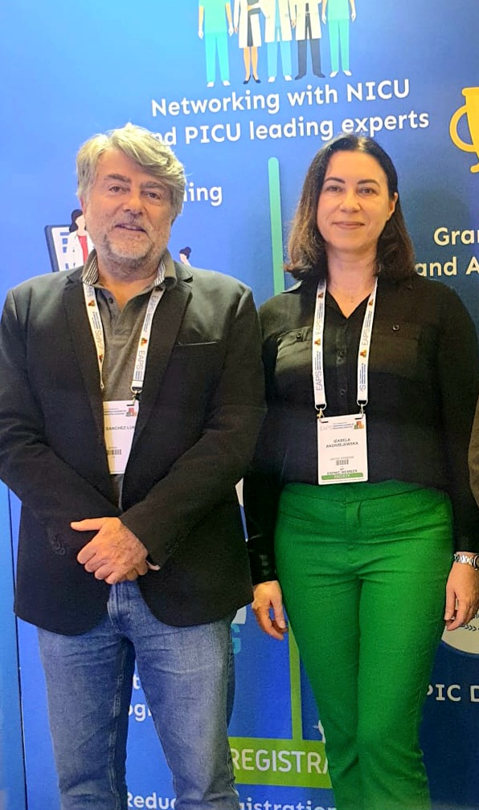
Welcome to the Neonatal Critical Care Section
• What?
The aim of the Neonatal Critical Care Section is to promote the best evidence-based practice, advocate for infants and their families and improve neonatal outcomes; building national and international collaboration platforms to enhance clinical effectiveness across Europe and beyond.
• When?
The new neonatal care section was created at the end of 2022.
Who?
Chair: Prof Manuel Sánchez-Luna Deputy Chair: Izabela Andrzejewska, RN

Slide 3
W
Why do we need Neonatal Critical Care Section?
WHO and UNICEF recently reported that nearly 30 million babies are born too soon or unwell and require specialist medical attention. The data from more than 15 European countries is reflecting the neonatal census with significant numbers of babies born <37 weeks of gestation (ref: e-Newborn).
In response to the global need, investment in education, training and creating the facility requires urgent attention.
We are aspiring to create a robust platform with a holistic approach to support neonatal professionals, vulnerable patients and their families.
REF: Neonatal Medicine Imperial College London
https://www.imperial.ac.uk/neonatal-data-analysis-unit/enewborn/enewborn-data-visualisations/

Slide 4
Welcome & introduction
Revision of action points
Neonatal Critical Care Section
Presented by: Prof Manuel Sánchez-Luna

Slide 5
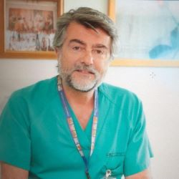
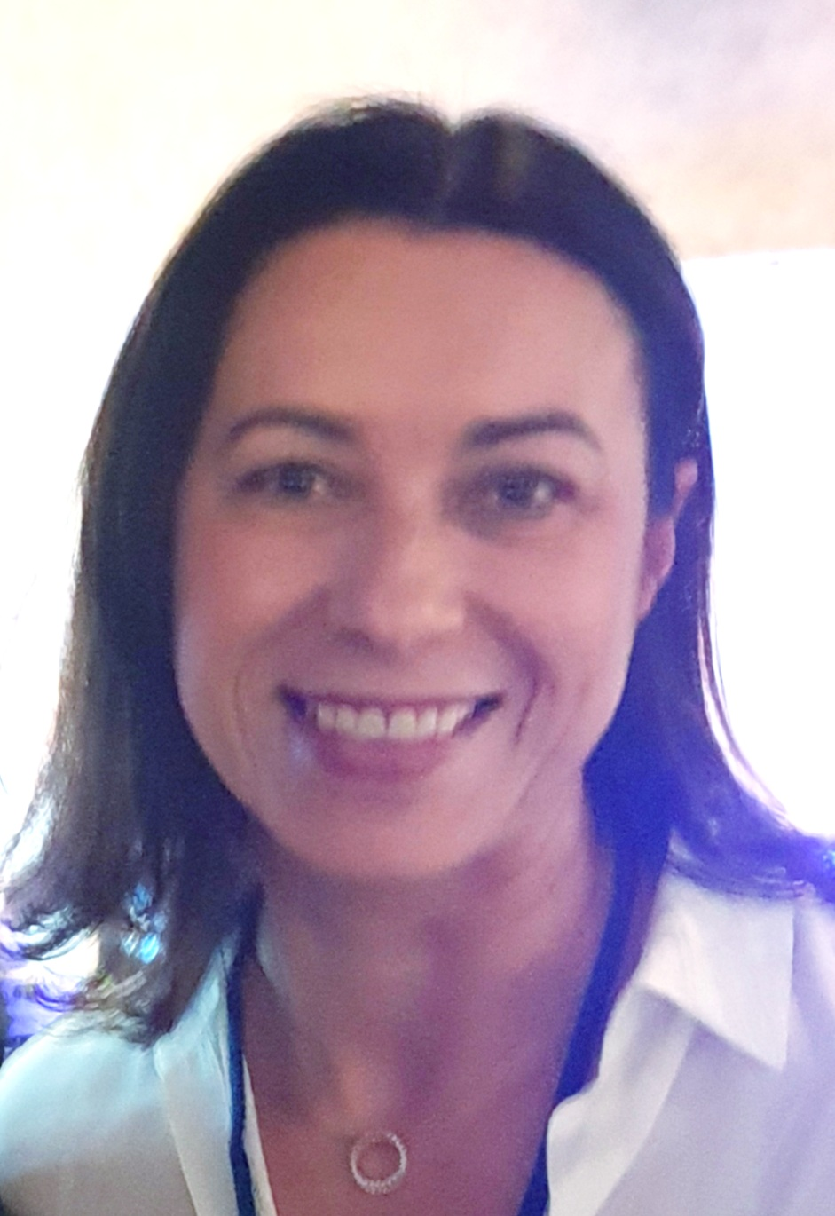
Who we are?
Chair: Prof Manuel Sánchez-Luna
Deputy Chair: Izabela Andrzejewska, RN
Medical Director of the Neonatology Division and NICU at HOSPITAL GENERAL UNIVERSITARIO “GREGORIO MARAÑON” Level IIIc, academic center associated to the Complutense University and belonging to the National Health System. Madrid (SPAIN) and Professor of Pediatrics and Neonatology of the Complutense University. Currently I’m the Past-President of the Union of European Neonatal and Perinatal Societies, and the President of the Spanish National Society of Neonatology. Areas of interest are lung protection of immature infants and personalized nutrition
Neonatal nurse, research lead and unit coordinator. She has been working on the Neonatal Intensive Care Level 3 Unit at Chelsea and Westminster Hospital in London (UK).
Izabela is committed to advance nursing practice to achieve excellence in neonatal care. She is leading the nursing research team, providing adequate training and engaging medical staff into research projects. Her interest is focused on quality of neonatal care, nursing practice improvement, parental satisfaction measures, enhancement of digital technology in neonatal settings, including AI.

Slide 6
You said - we are responding

Slide 7
Events
Meeting new members (Barcelona 2022)
Therapeutic hypothermia (online teaching session for medical professional from Ukraine)
Neosim collaboration - simulation course
Neonatal Lung Ultrasound course

Slide 8
Team is all about it
• collaboration
• communication
• commitment

Slide 9
Neonatal section summary of activities
Formation of Education Committee
The aim of the NCC section is to address aspect of neonatal care improvement,
education and training
Overview of Current Activities
Education Needs Assessment for ESPNIC members
Response to the members needs indicated in the survey
Overview of existing materials on online portal
Exploring an upload of related publication
Preparation of online courses and events
Lung USS in progress

Slide 10
Any questions? Info@espnic.eu
Notes:
Follow up email: link to recording and membership

