Slide 1
ESPNIC Infection, Inflammation and Sepsis Section
Report activities 2022-2023
Luregn Schlapbach and Gabriella Bottari
June 2023

Slide 2
EDUCATIONAL ACTIVITIES
Webinar on PIM-TS/MIS-C
MARCH 2022
Physiopathology: Discovery of a new disease - what we know ? (Michael J Carter, King College London, UK)
Best management: Evidence and new trials for the treatment of PIMS-TS (Elisabeth Whittaker, Imperial College London)
Masterclasses on pediatric septic shock:
BASIC COURSE
June 2022
Streaming pre-recorded lectures, panel discussion and interactive breakout rooms
Pre-congress WORKSHOP , ESPNIC 2023 Athens
20 June 2023

Slide 3
EDUCATIONAL ACTIVITIES
WFIPICCS endorsed sepsis webinar – May 2023 PICU SEPSIS AWARNESS WEEK

Slide 4
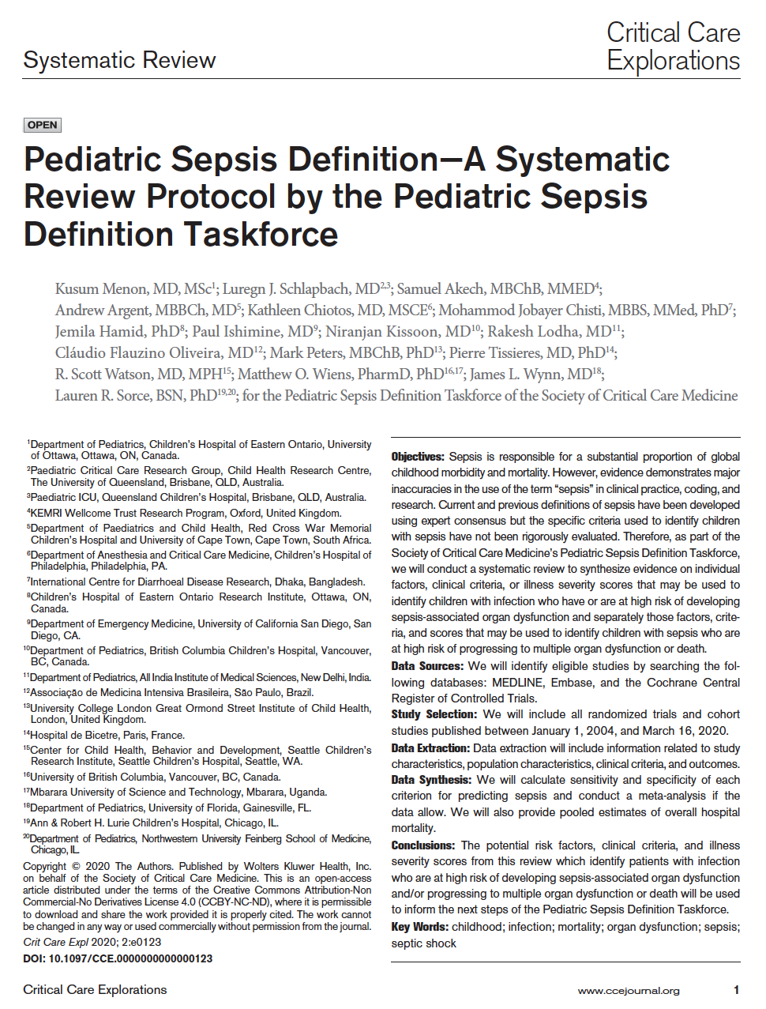
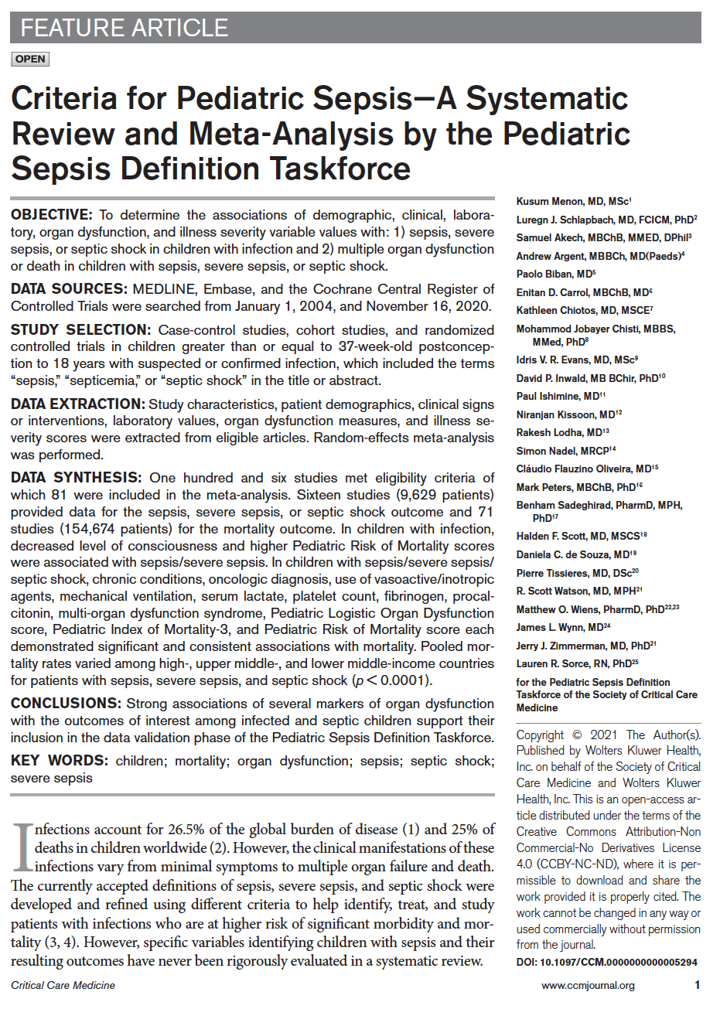
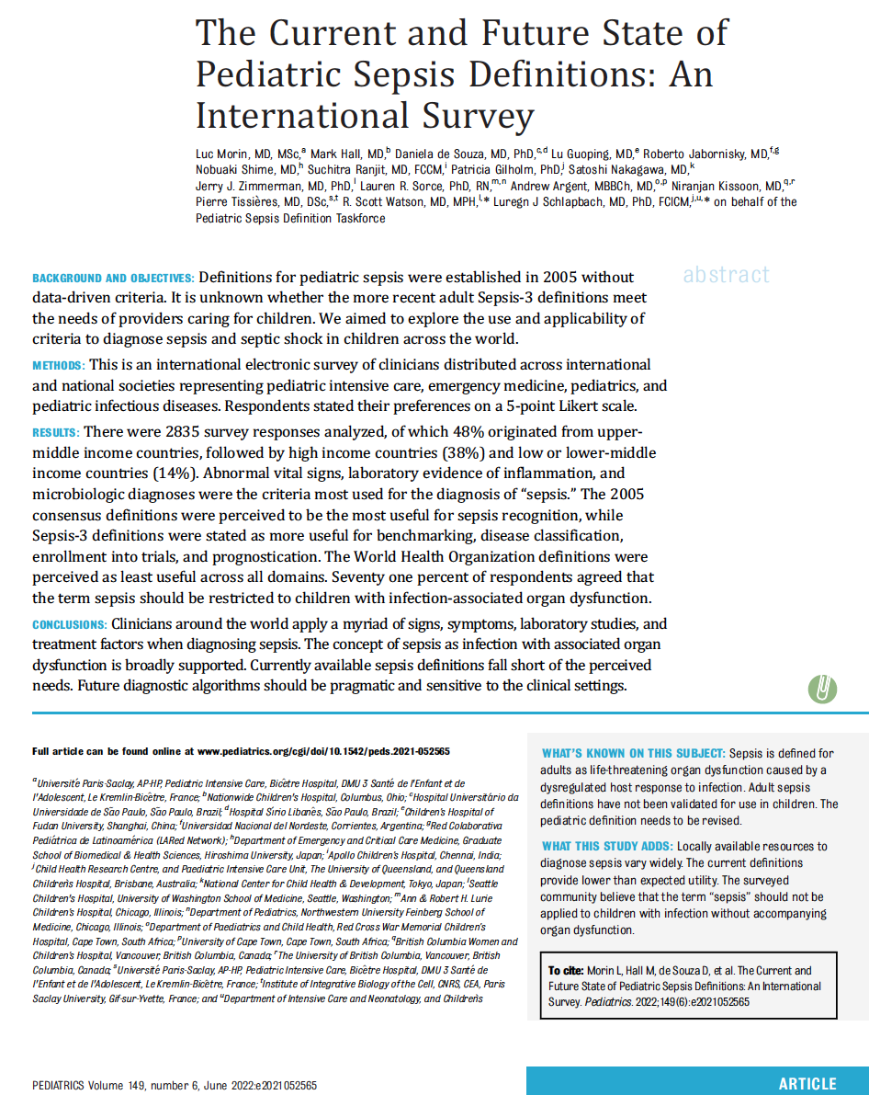
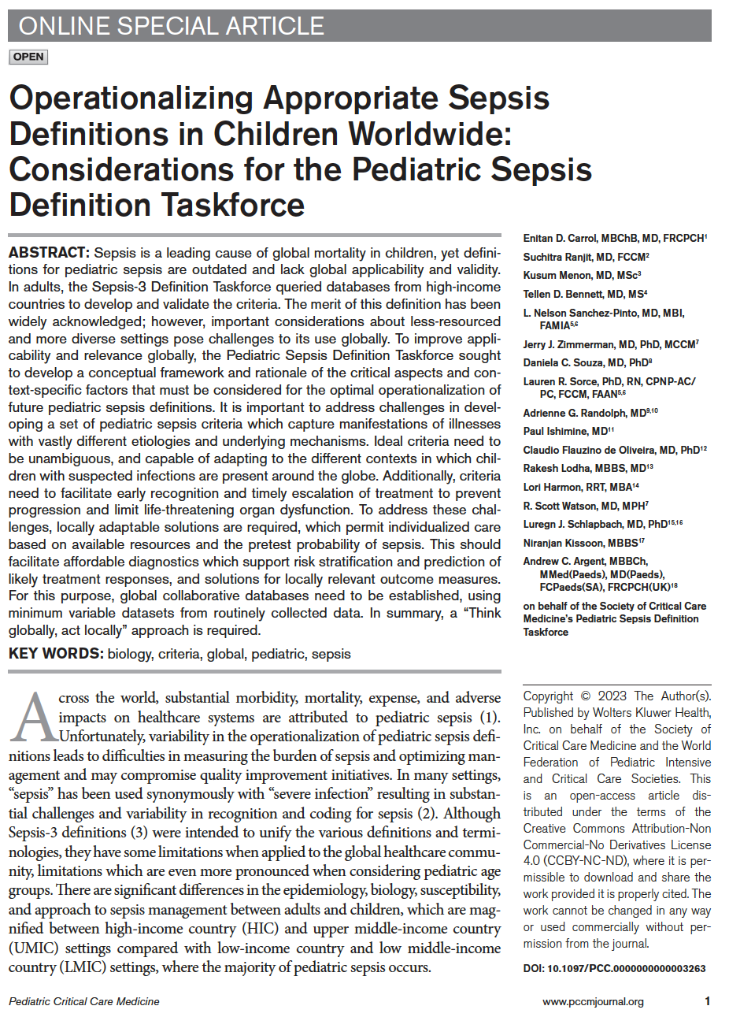
PEDIATRIC SEPSIS DEFINITION TASKFORCE
SCCM funded, Co-Chaired SCCM (Scott Watson) and ESPNIC (Luregn Schlapbach) 37 members from HIC+LMIC, PICU, ED, ID, PH including several ESPNIC members
Databases from 3.5 Mio encounters from 3 continents accessed to derive new sepsis criteria
Currently during Delphi voting phase; Release of criteria anticipated Jan 2024 SCCM Phoenix
Menon PCCM 2023

Slide 5
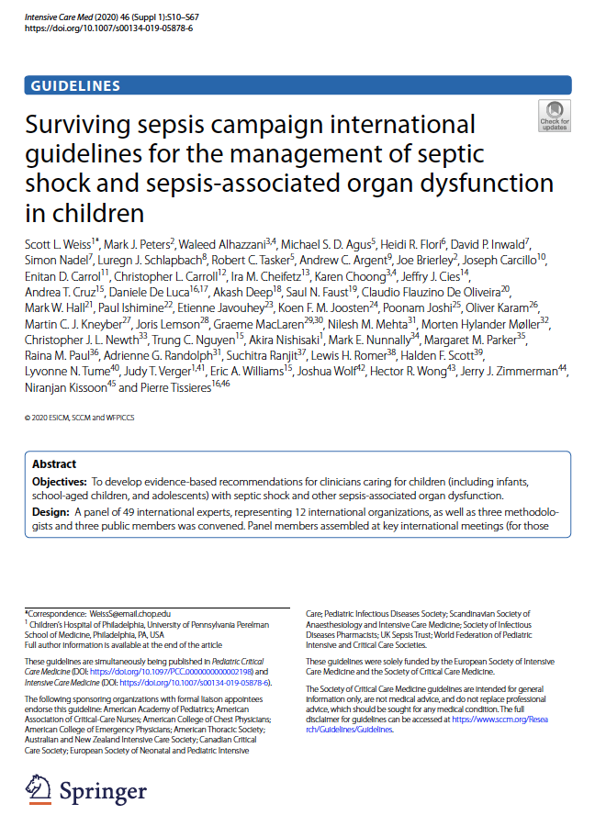
PEDIATRIC SURVIVING SEPSIS CAMPAIGN
SCCM – ESICM/ESPNIC co-funded, Co-Chaired SCCM (Scott Weiss, Tex Kissoon) and ESPNIC (Mark Peters, Pierre Tissieres) members from HIC+LMIC, PICU, ED, ID including many ESPNIC Infection/Sepsis section members
Timeline anticipating kick-off later 2023, main body of work 2024/2025
- ACCCM 2007-2014 update published 2017
- SSC update started in 2017, published 2020
Move towards more agile guidelines with faster updating?

Slide 6
WHITE PAPER ON INTERNATIONAL PICU TRIAL COLLABORATION
Co-Chaired Luregn Schlapbach (ESPNIC), Kusum Menon (CCCTG)
Bring together all PICU trial networks (ESPNIC, PICCS-SG, PALISI, PACMAN, ANZICS PSG, LARED/SLACIP, Africa)
ESPNIC Reps: Akash Deep, Lyvonne Thume, Roelie von Asperen, Martin Kneyber
Workshops to define state-of-the-art, challenges, opportunities, and roadmap for PICU trials
Kick off Mai 2023, completion end of 23, publication 2024

Slide 7
RESEARCH ACTIVITIES
Proposed focus areas
2023: Blood purification in critically ill children – (Gabriela Bottari)
1. International survey across PICUs
2024: Development of Antibiotic Stewardship Guidelines for PICUs (Luregn Schlapbach)

Slide 8
Blood purification in critically ill children International survey across PICUs
MODIEFIED DELPHI METHOD
Round 1
Round 2
Round 3
Qualitative round
Panel list drafted the questionnaire
Round 1 questionnaire findings
Panel list will be ask to reconsider answers of the second round
Panel list
selection
inside ESPNIC
September 2021
June 2022
November 2022
DRAFT WILL BE PRESENTED DURING ISS SECTION MEETING IN ATHENS

Slide 9
Antimicrobial Stewardship in PICU
Publication: Clos M, Schlapbach LJ, Arata-Bardet J, Javouhey E, Mortamet G, on behalf of European Society of Neonatal and Pediatric Intensive Care (ESPNIC) Section on Infection, Inflammation, and Sepsis. Eur J Pediatr. 2022 Jul;181(7):2873-2877. doi: 10.1007/s00431-022-04481-0. Epub 2022 Apr 25.
Several interested members; full work not initiated yet due to Taskforce & Blood purification work being prioritized
ESPNIC white paper on AMS in PICU to be prepared and worked on in 2024-25; partnership with ECCMID/ESPID will be sought

Slide 10
Discussion points
Quality improvement in paediatric sepsis?
Initially aimed to be focused on Europe, but Lancet Child Adolescent Health editor requested this to be part of a paediatric sepsis series with more global focus; Work started in June 2023: Series lead: Luregn Schlapbach, QI paper lead: Tex Kissoon, Daniela de Souza
How to promote European Sepsis QI activities across ESPNIC?
Exchange with ESPR Infection&Sepsis section (Chair Eric Giannoni)?

Slide 11
New Proposals - 2024
Discussion

Slide 12
ORGANISATION OF THE SECTION
Do you have new/additional projects to propose?
Please send email to luregn.schlapbach@kispi.uzh.ch and to gabriella.bottari@opbg.net
See you at the Infection, Inflammation, and Sepsis section meeting in ATHENS /
on 21st June from 12.30 to 13.30 at Conference Room 1
Input and feedback from Section members is most welcome! Let`s engage junior staff members/trainees, nurses, and allied health too!!!

